Slide 1

DESIGN AND ANALYSIS OF ALGORITHMS(24UAMPC204) Introduction to Algorithm Unit -I
Sanjivani University
School of Engineering and Technology
Department of AIML
By,
Prof. Chanda Pathak

Slide 2
Contents
Introduction to Algorithm
Analysis of Algorithm
Space complexity
Time complexity
Asymptotic Notations
Big oh notation(O)
Omega notation(Ω)
Divide and conquer(General method- applications)
Binary search
Merge sort
Quick sort
Strassen’s Matrix Multiplication

Slide 3
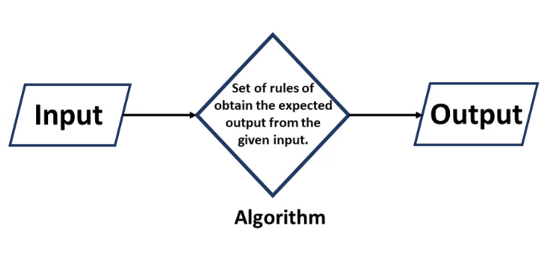
Introduction to Algorithm
An algorithm is a step-by-step procedure or set of rules designed to solve a specific problem or perform a particular task. Think of it like a recipe that provides precise instructions to achieve a desired outcome.
A procedure for solving a mathematical problem in a finite number of steps that frequently involves recursive operations.
A set of finite rules or instructions to be followed in calculations or other problem-solving operations
Notes:
Definition of Algorithm
An algorithm is:
A set of finite rules or instructions for calculations or problem-solving.
A procedure to solve a mathematical problem in a finite number of steps, often involving recursion.
Definition-An algorithm is a set of commands that must be followed for a computer to perform calculations or other problem-solving operations. According to its formal definition, an algorithm is a finite set of instructions carried out in a specific order to perform a particular task. It is not the entire program or code; it is simple logic to a problem represented as an informal description in the form of a flowchart or pseudocode.
Use of Algorithms
Algorithms are fundamental across various domains:
Computer Science: From sorting and searching to AI and ML tasks.
Mathematics: Solving equations, finding paths in graphs.
Operations Research: Optimization in logistics, transportation.
AI & Machine Learning: Tasks like image recognition and decision-making.
Data Science: Analyzing data, predictions in healthcare, finance, etc.
Need for Algorithms
Algorithms:
Solve complex problems efficiently.
Automate and optimize processes.
Enable tasks that are challenging or impossible manually.
Characteristics of an Algorithm
Clear and Unambiguous: Each step must be precise and meaningful.
Well-Defined Inputs & Outputs: Inputs and results should be clearly specified.
Finiteness: Must terminate after a finite number of steps.
Feasibility: Practical and executable with available resources.
Language Independence: Instructions work regardless of programming language.
Properties of an Algorithm
Finite termination.
At least one output.
Deterministic (consistent output for the same input).
Effective (each step performs meaningful work).
Types of Algorithms
Brute Force: Simplest and exhaustive approach.
Recursive: Problem-solving via repeated subproblem solutions.
Backtracking: Tracing back upon failure to find solutions.
Searching & Sorting: Locating or arranging data efficiently.
Hashing: Indexing data for faster retrieval.
Divide and Conquer: Splitting problems into smaller subproblems.
Greedy: Choosing the immediate optimal solution.
Dynamic Programming: Avoids recalculation by storing results of overlapping subproblems.
Randomized: Uses random numbers for unpredictable yet beneficial outcomes.
Advantages of Algorithms
Clear problem-solving steps.
Easier translation into code.
Breaks down problems into smaller, manageable parts.
Disadvantages of Algorithms
Time-consuming to write.
Challenging to represent complex logic.
Hard to show branching/loops effectively.

Slide 4
Characteristic of an algorithm
Clear and unambiguous
Well defined inputs
Well defined outputs
Finiteness
Feasible
Language independent
Notes:
Unambiguous − Algorithm should be clear and unambiguous. Each of its steps (or phases), and their inputs/outputs should be clear and must lead to only one meaning.
Input − An algorithm should have 0 or more well-defined inputs.
Output − An algorithm should have 1 or more well-defined outputs, and should match the desired output.
Finiteness − Algorithms must terminate after a finite number of steps.
Feasibility − Should be feasible with the available resources.
Independent − An algorithm should have step-by-step directions, which should be independent of any programming code.

Slide 5
Analysis of Algorithm
The algorithm may be studied in two levels: first before it is made and then, after it is created. The two analyses of algorithm are as follows :
Priori Analysis Posterior Analysis
Notes:
Priori Analysis − This is a theoretical analysis of an algorithm. Efficiency of an algorithm is measured by assuming that all other factors, for example,
processor speed, are constant and have no effect on the implementation.
Posterior Analysis − This is an empirical analysis of an algorithm. The selected algorithm is implemented using programming language. This is then
executed on target computer machine. In this analysis, actual statistics like running time and space required, are collected.

Slide 6
Analysis of Algorithm
The procedures of an algorithm in simple words:
Step 1: Define the Problem
Step 2: Plan the Solution
Step 3: Write the Algorithm
Step 4: Test the Algorithm
Step 5: Refine the Algorithm
Step 6: Implement the Algorithm
Step 7: Run the Program
Step 8: Maintain the Program
Notes:
Definition:
Algorithm analysis is the process of determining the amount of computing resources (like time and memory) that an algorithm needs
It helps us predict the behavior of an algorithm without implementing it
Analysis of algorithms is the process of evaluating the performance of an algorithm in terms of its time and space requirements.
Why Analyze Algorithms?
To compare different algorithms for the same problem
To predict performance on different input sizes
To understand scalability
To make informed choices in software development
To optimize resource usage

Slide 7
Algorithm complexity, Space complexity
Space complexity
Time Complexity
Space complexity
The space Complexity of an algorithm is the total space taken by the algorithm with respect to the input size. Space complexity includes both Auxiliary space and space used by input.
Space Complexity = Auxiliary Space + Input Space means the total memory space an algorithm uses is the sum of:
Input Space: The memory needed to store the input
Auxiliary Space: Extra memory needed during algorithm execution
i.e, the temporary space used by an algorithm in addition to the space used by the input is called auxiliary space.

Slide 8
Time Complexity
Time complexity measures how the amount of time an algorithm takes to complete grows as the size of the input increases. It helps us understand how efficiently an algorithm performs when handling larger data. The purpose of time complexity is to analyze and predict the performance of an algorithm by understanding how its execution time scales with the size of its input.
Time complexity is a measure of the amount of time an algorithm takes to complete as a function of the size of the input. It is usually expressed as a big O notation, which gives an upper bound on the number of steps the algorithm takes.
Best-case complexity: his represents the minimum time required for an algorithm to complete when given the optimal input. It denotes an algorithm operating at its peak efficiency under ideal circumstances.
Worst-case complexity: This denotes the maximum time an algorithm will take to finish for any given input. It represents the scenario where the algorithm encounters the most unfavorable input.
Average-case complexity:This estimates the typical running time of an algorithm when averaged over all possible inputs. It provides a more realistic evaluation of an algorithm's performance.

Slide 9
Asymptotic Notations- Big-o notation- Omega notation
Asymptotic Notations- Asymptotic notation describes algorithm efficiency & performance using the behavior of time or space complexity for large instance characteristics. An asymptotic notation essentially describes the running time of an algorithm. This means that it shows how much time the algorithm takes to run with a given input.
Asymptotic notations are used to represent the complexities of algorithm for asymptotic analysis. These notations are mathematical tools to represent the complexities. There are three notations that are commonly used.
There are mainly three asymptotic notations:
Big-O Notation (O-notation)
Omega Notation (Ω-notation)
Theta Notation (Θ-Notation)

Slide 10
Big O (Upper Bound): The maximum amount of time or space an algorithm requires.
Big Ω (Lower Bound): The minimum amount of time or space an algorithm requires.
Big Θ (Tight Bound): The exact amount of time or space an algorithm requires.

Slide 11
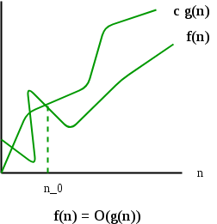
Big-O Notation
Big-O notation is a way to measure how long an algorithm takes to complete. It's like a speed limit sign that shows the maximum time an algorithm can take.
O(g(n)) = { f(n): there exist positive constants c and n0 such that 0 ≤ f(n) ≤ cg(n) for all n ≥ n0 }
It is the most widely used notation for Asymptotic analysis.
It specifies the upper bound of a function.
It returns the highest possible output value(big-O) for a given input.
Big-O(Worst Case) It is defined as the condition that allows an algorithm to complete statement execution in the longest amount of time possible.

Slide 12
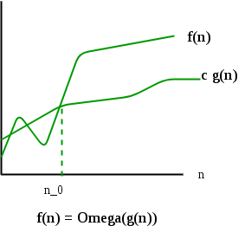
Omega notation
Omega Notation (Ω) is used to describe the lower bound of an algorithm's running time. It represents the best-case complexity, indicating the minimum amount of time an algorithm will take to complete.
Ω(g(n)) = { f(n): there exist positive constants c and n0 such that 0 ≤ cg(n) ≤ f(n) for all n ≥ n0 }

Slide 13
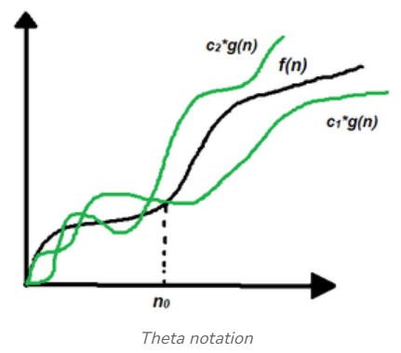
Theta Notation (Θ-Notation)
Theta notation encloses the function from above and below. Since it represents the upper and the lower bound of the running time of an algorithm, it is used for analyzing the average-case complexity of an algorithm.
Θ (g(n)) = {f(n): there exist positive constants c1, c2 and n0 such that 0 ≤ c1 * g(n) ≤ f(n) ≤ c2 * g(n) for all n ≥ n0}

Slide 14
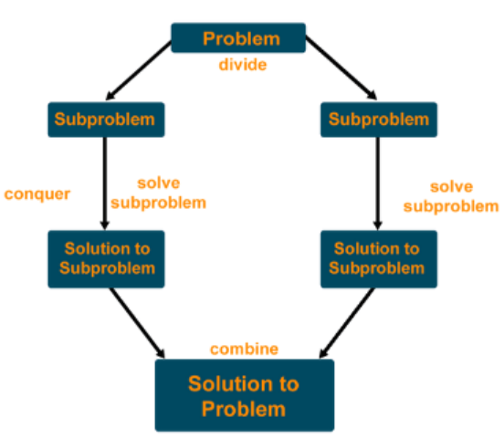
Divide and conquer
Divide and Conquer is a problem-solving technique that solves complex problems by breaking them into smaller subproblems, solving each subproblem individually, and then combining their solutions to solve the original problem. It's a widely used approach in algorithm design, especially for problems that can naturally be divided into independent smaller tasks.

Slide 15
Divide and conquer
1. Divide the actual problem into sub-problems (A subproblem is just a smaller instance of the same problem).
2. Conquer i.e. recursively solve each sub-problem.
3. Combine the solutions of the sub-problems to get the solution to the actual problem.
Applications of Divide and Conquer Algorithm:
Binary Search
Quicksort
Merge Sort
Strassen’s Matrix Multiplication
Notes:
Divide:
Break the big problem into smaller, easier parts.
Keep dividing until you reach the simplest pieces that can’t be split further.
Think of it like cutting a big pizza into smaller slices.
Conquer:
Solve each small piece one by one.
If a piece is super small (the base case), solve it directly without breaking it anymore.
Treat each piece like solving a mini-puzzle.
Merge:
Put the solved pieces back together to solve the big problem.
Combine the answers step by step to get the final solution.
It’s like putting the mini-puzzles back together to complete the whole picture.

Slide 16
Binary Search
Binary search is a search algorithm used to find the position of a target value within a sorted array. It works by repeatedly dividing the search interval in half until the target value is found or the interval is empty. The search interval is halved by comparing the target element with the middle value of the search space.
Find the middle element of the current search range.
If the middle element matches the target value, the search is complete, and the index of the middle element is returned.
If the target value is smaller than the middle element, repeat the search in the left half of the list.
If the target value is larger than the middle element, repeat the search in the right half of the list.
This process continues until the target is found or the search range is exhausted.

Slide 17
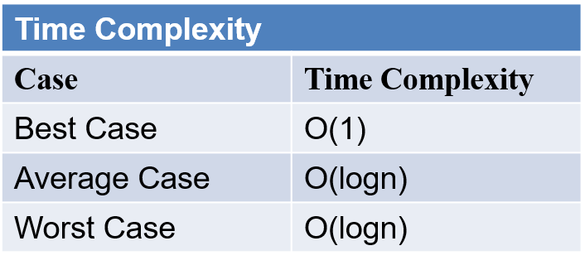
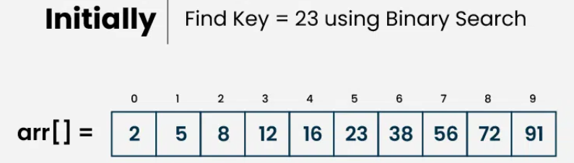
Consider an array arr[] = {2, 5, 8, 12, 16, 23, 38, 56, 72, 91}, and the target = 23

Slide 18
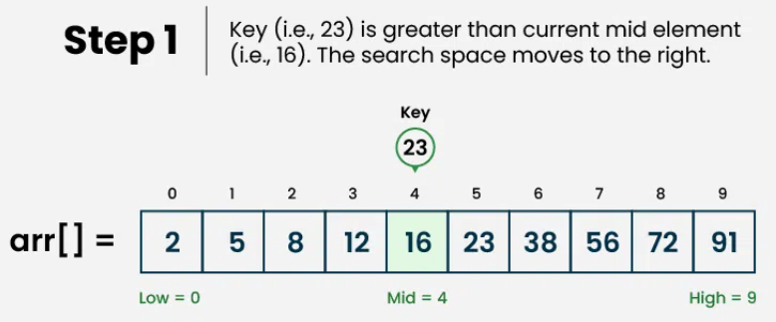
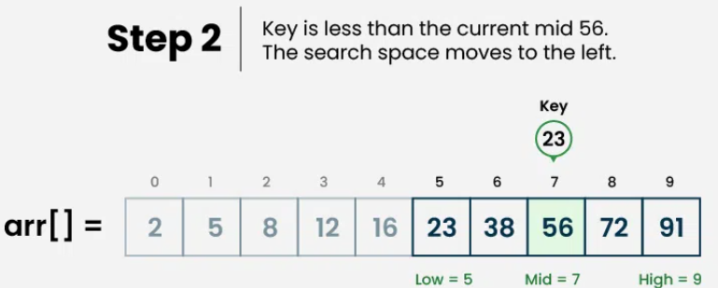
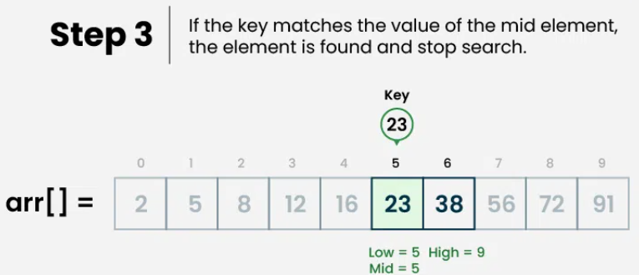

Slide 19
Binary Search Algorithm(Recursive)
Binary_Search(a, lower_bound, upper_bound, val) // 'a' is the given array, 'lower_bound' is the index of the first array element, 'upper_bound' is the index of the last array element, 'val' is the value to search
Step 1: set beg = lower_bound, end = upper_bound, pos = - 1
Step 2: repeat steps 3 and 4 while beg <=end
Step 3: set mid = (beg + end)/2
Step 4: if a[mid] = val
set pos = mid
print pos
go to step 6

Slide 20
9. else if a[mid] > val
10. set end = mid - 1
11. else
12. set beg = mid + 1
13. [end of if]
14.[end of loop]
15.Step 5: if pos = -1
16.print “value is not present in the array"
17.[end of if]
18.Step 6: exit

Slide 21
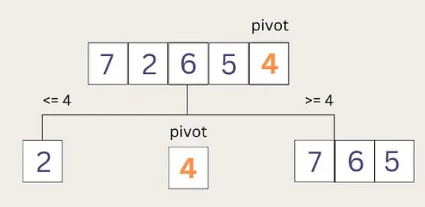
Quick sort
Quicksort is a sorting algorithm based on Divide and conquer the that picks an element as a pivot and partitions the given array around the picked pivot by placing the pivot in its correct position in the sorted array.
Steps of Quick Sort:
Pick a Pivot: Choose an element from the list (can be the first, last, or a random element).
Partitioning:
Move all smaller elements to the left of the pivot.
Move all larger elements to the right of the pivot.
Recursively Sort: Apply Quick Sort to the left and right subarrays.
Combine: Since all elements are in the right place, the list is now sorted!

Slide 22
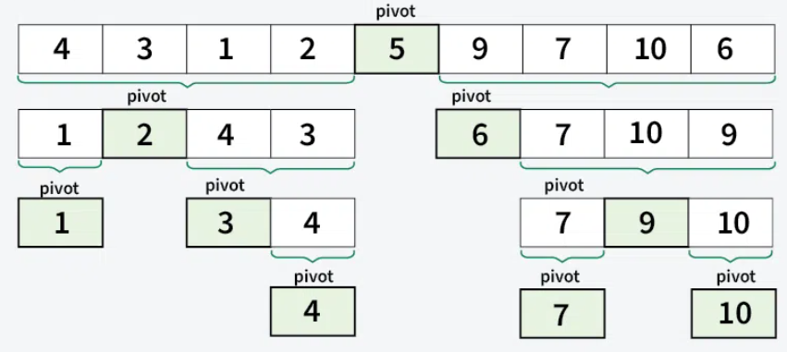
Basic Overview of how the QuickSort algorithm works.

Slide 23
Quick Sort Algorithm
QUICKSORT (array A, start, end)
{
1 . if (start < end)
2. {
3. p = partition(A, start, end)
4. QUICKSORT (A, start, p - 1)
5. QUICKSORT (A, p + 1, end)
6. }
}
Time complexity:
Case | Time complexity
Best Case | O(n*logn)
Average Case | O(n*logn)
Worst Case | O(n²)

Slide 24
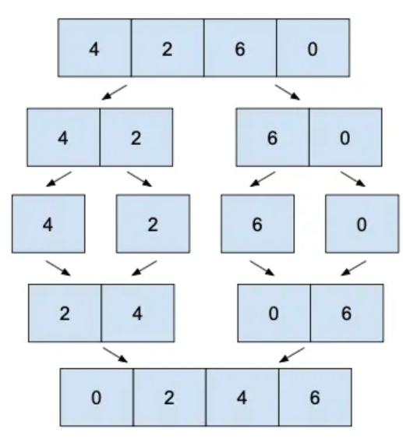
Merge sort
Merge sort is a sorting algorithm that follows the Divide and conquer approach. It works by recursively dividing the input array into smaller subarrays and sorting those subarrays then merging them back together to obtain the sorted array.
How Merge Sort Works:
Divide: The array is divided into two halves (recursively) until each subarray contains only one element.
Conquer: Each subarray is sorted (which is trivial because a single element is already sorted).
Merge: The sorted subarrays are merged back together in sorted order to produce the final sorted array.

Slide 25
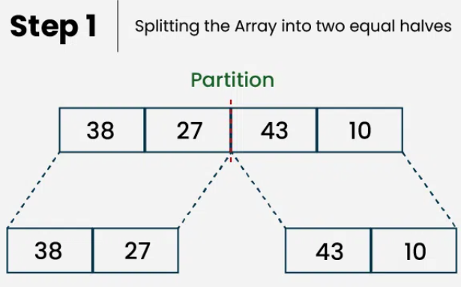
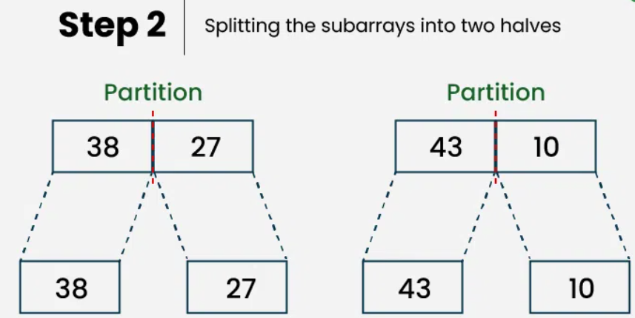
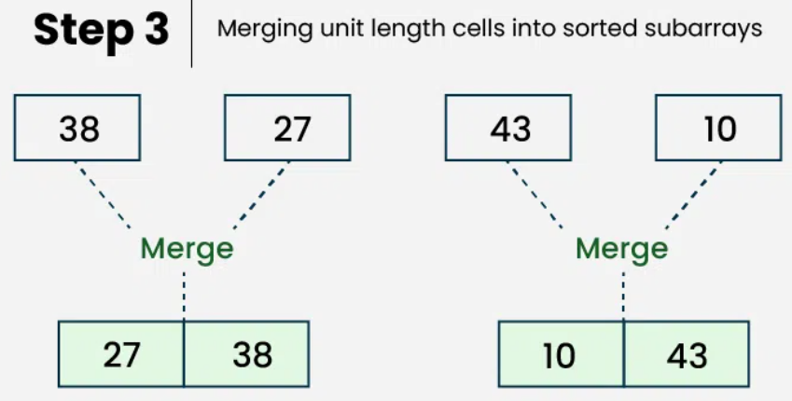
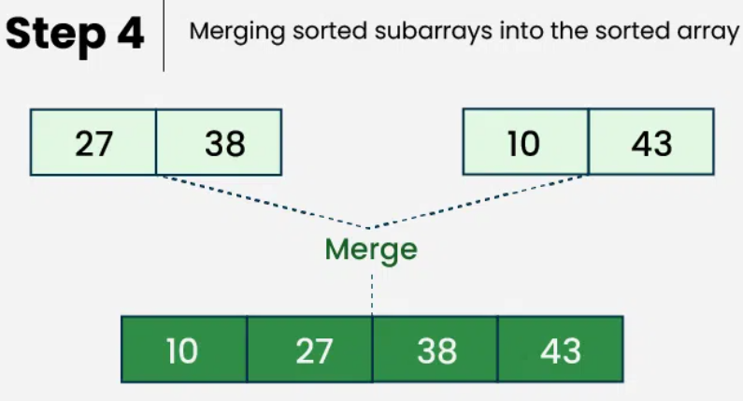

Slide 26
Algorithm for Merge Sort
In the following algorithm, arr is the given array, beg is the starting element, and end is the last element of the array.
MERGE_SORT(arr, beg, end)
if beg < end
set mid = (beg + end)/2
MERGE_SORT(arr, beg, mid)
MERGE_SORT(arr, mid + 1, end)
MERGE (arr, beg, mid, end)
end of if
END MERGE_SORT
Aspect | Complexity
Time Complexity | O(n log n)
Space Complexity | O(n)

Slide 27
Strassen’s Matrix Multiplication
It is a fast algorithm for matrix multiplication. It is an efficient divide-and-conquer method that reduces the number of arithmetic operations required to multiply two matrices compared to the conventional matrix multiplication algorithm
Algorithm:
Base Case (Smallest Matrix)
If the matrix size is 1 × 1, multiply the elements directly and store the result.
Divide the Matrix
Split each n × n matrix (A and B) into four equal submatrices of size n/2 × n/2.
Similarly, divide the result matrix R into four parts.

Slide 28
3. Recursive Multiplication Using Strassen’s Method
Compute seven matrix products using Strassen’s formula:
M1 = (A11 + A22) × (B11 + B22)
M2 = (A21 + A22) × B11
M3 = A11 × (B12 − B22)
M4 = A22 × (B21 − B11)
M5 = (A11 + A12) × B22
M6 = (A21 − A11) × (B11 + B12)
M7 = (A12 − A22) × (B21 + B22)

Slide 29
4. Combine the Results to Form the Final Matrix R
Compute the submatrices of R as follows:
R11 = M1 + M4 − M5 + M7
R12 = M3 + M5
R21 = M2 + M4
R22 = M1 − M2 + M3 + M6
5. Repeat the Process Recursively
Continue dividing and computing until the base case (1 × 1 matrix) is reached.
6. Final Output
The matrix R contains the result of A × B.
The complexity of Strassen’s matrix multiplication algorithm is O(n)
Log7

